Slide 1
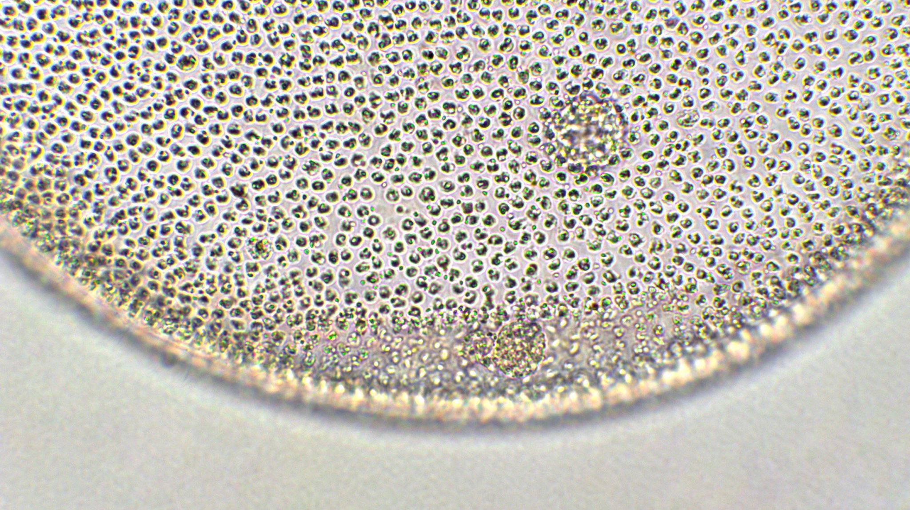
Commentary on “Being functionalist about Scientific perspectivism”
Lu Chen
Koc University (Istanbul, Turkey)

Slide 2
A Recap
Ioan aims to provide a modelling-theoretic account of scientific perspectivism.
What is scientific perspectivism?
  What counts as scientific truth or knowledge is dependent on scientific perspectives, which are constituted by all sorts of things relevant to scientific practice, incl. experimental technologies, measurement apparatus, background assumptions, models, methods, goals, values, interests, standards.
How do we approach models under scientific perspectivism (or conversely…)?
  Model representationism. The main function of a model is to represent a target system as accurately as possible.
  Perspectival model representationism. The accuracy of a model as a representation is dependent on the perspectives. Ioan aims to offer an account (or implementation) of perspectival model representationism, which he calls the functionalist approach.

Slide 3
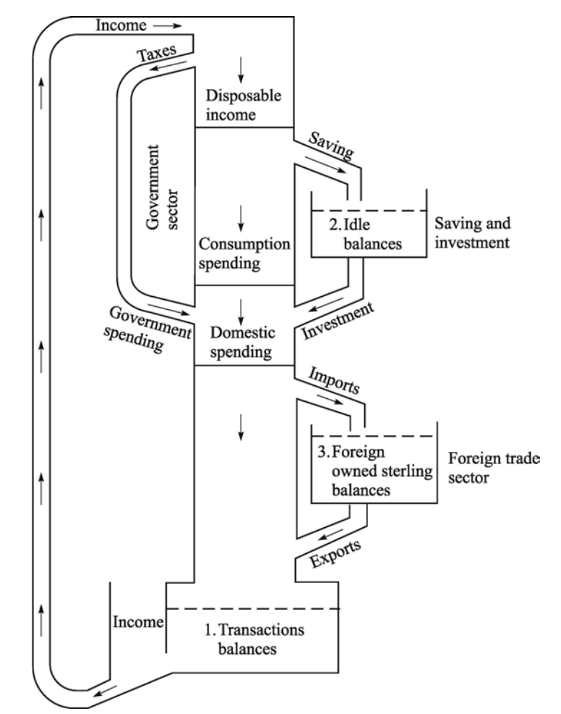
A Recap
4. The DEKI approach to model. A model represents a target system through four relations: 1. Denotation; 2. Exemplification; 3.Key-in, or mapping; 4. Imputation. (Roman Frigg and James Nguyen)
Example: water pipes as an economic model
  The water-pipes system denotes the UK economy through the intention of the modeler.
  The system exemplifies economy-features such as the circulation period.
  Mapping: An interval key translates the circulation period feature of the system to the circulation period of the UK economy.
  The model imputes such features to the UK economy

Slide 4
A Recap
5. Ioan’s proposal: A scientific perspective is a restriction or expansion of the mapping/key-in relation in the DEKI approach.
  Let p be credence. Let P be the set of features exemplified by the model in question. Let K be the key-in mapping. Let R be the set of relevant properties of the target system T.
  Ioan proposes that the accuracy of a model as a representation of T relative to a scientific perspective can be formulated as:

Slide 5
A recap
6. The advantages of Ioan’s proposal:
  Account for the convergence of models based on different perspectives
  Stability of models across perspectives

Slide 6
My Comments: 1. why scientific perspectivism (SP)?
Ioan did not motivate it in the paper, so I would like to learn more about its motivations, which will help me understand the value of Ioan’s proposal.
  As I understand it, SP is motivated by the observation that we are always limited to the human perspective, and also to the perspective of a time (affected by technology, measurement devices, standard, interest, etc).
Question: do we need to have an account of how perspectives progress in order to account for scientific progress? If no, why not? If yes, what is the advantage of SP over scientific realism?
Scientific realism does not deny that our understanding of reality is always constitutive of the human perspective (our cognitive function), and is under no illusion that our current theory is unsupersedeable by future theories.
  But it aims to identify some theoretical content that will likely be retained by all future theories independent of scientific perspectives. The accumulation of such content (in addition to predictive success) account for the progress of science.
  E.g., Effective realism: a scientific theory---in particular, a physical theory---is only valid up to an energy scale and is expected to break down beyond that scale. The theoretical content within that scale is expected to hold regardless of what high-energy physics comes to be.

Slide 7
2. Why being functionalist about SP?
i. Ioan explicates SP as our credence in the accuracy of the mapping between the exemplary features of a model and the features of the target system.
Given that SP is motivated by the complexity of all the things that affect scientific practice at a time, I wonder why should we be limited to modifying the key-in mapping of a model when changing perspectives? Why not change all the other relations like denotation, interpretation/exemplification, and imputation? And why not change the modelling account altogether?
In other words, why is stability of models across perspectives (the second virtue) something that SP wants?

Slide 8
2. Why being functionalist about SP?
ii. I also have trouble understanding the first virtue the convergence of models based on different perspectives.
First of all, why should we think there is a convergence of models at all? I would appreciate some historical examples to illustrate this point. From a naïve interpretation of historical cases, I cannot see that the model for Newtonian gravity converges to the model for general relativity and the latter converges to the (effective) theory of quantum gravity. Or that the model for the ether optics converges to quantum theory of electromagnetism.
Second, how is such a convergence, if any, modelled by updating our beliefs in the key-in functions of the relevant models?

Slide 9
3. Details of the proposal
I have many questions about the details. For example:
i. Ioan mentions that one’s belief in the accuracy of model representation in a non-perspectival way can be formulated as
p(K(Q) ⊂ R) > θ
Why in Ioan’s formulation is it K(P) ⊃ R (the direction is reversed) that is involved?
ii. Why does the denominator in
need to include both p(K(P) ⊃ -R) and p(-K(P) ⊃ R) and p(-K(P) ⊃ -R)?
iii. Why is the belief in the accuracy represented by the credence in overlapping of K(P) and R rather than the similarity between them? E.g. the actual circulation period – circulation period being represented.
iv. Doesn’t the degree of overlap also depend on the imputation relation?

